Slide 1
Greenhouse Gas Inventory Project

Slide 2
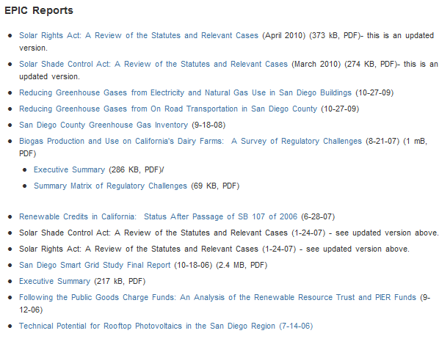

Slide 3
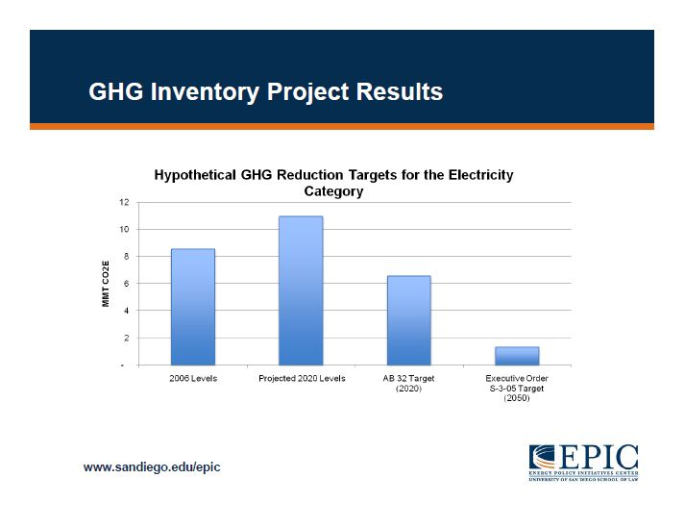

Slide 4
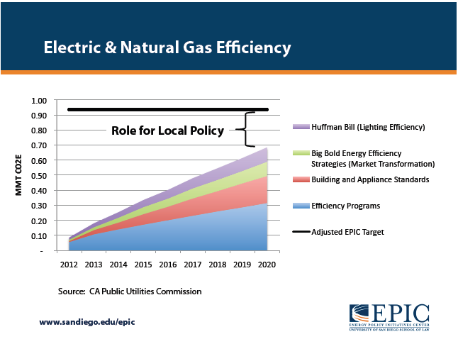

Slide 5
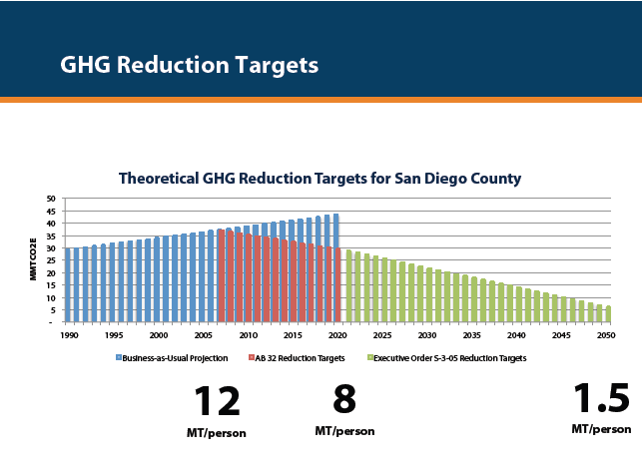

Slide 6
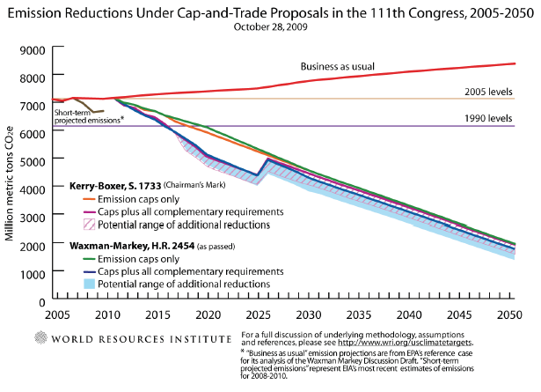

Slide 7
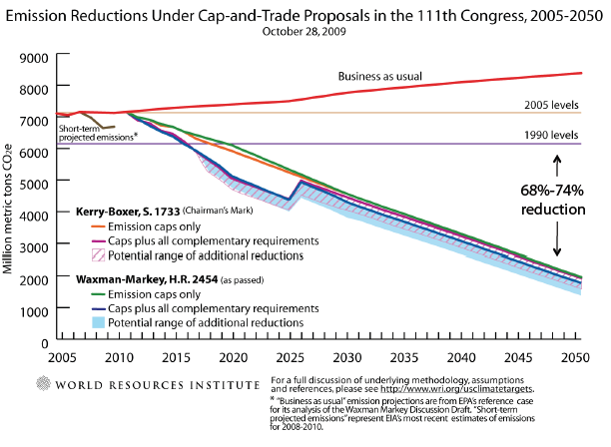

Slide 8
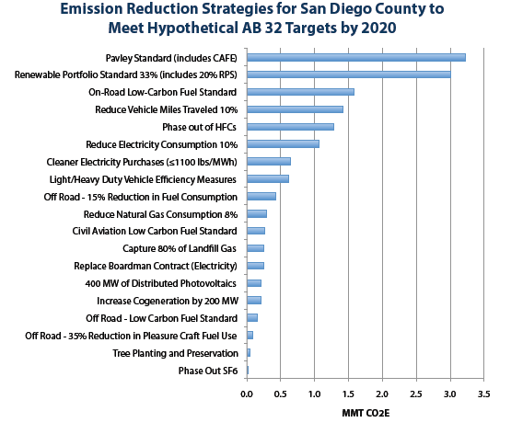

Slide 9
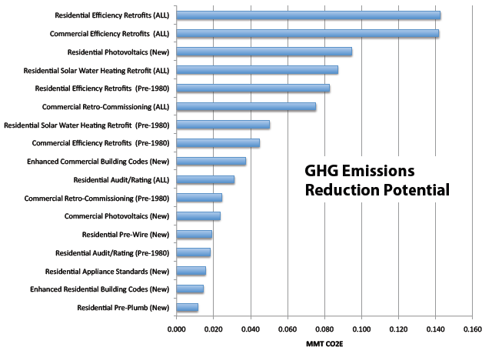

Slide 10
Sunrise Power Link Map

Slide 11
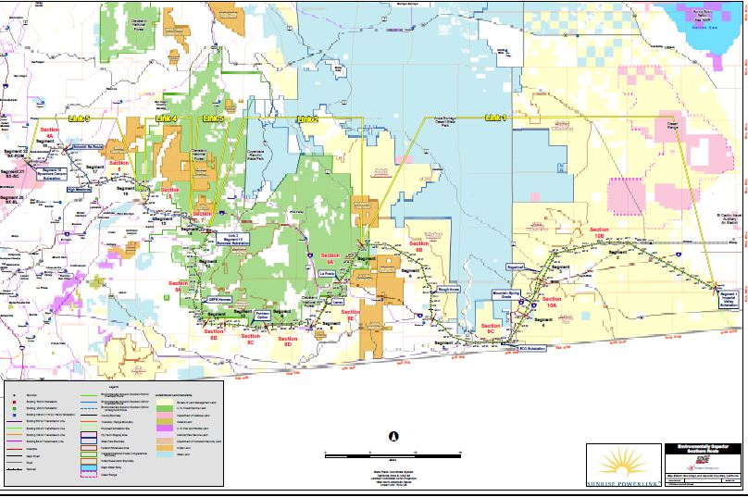

Slide 12
California Energy Commission 2007

Slide 13
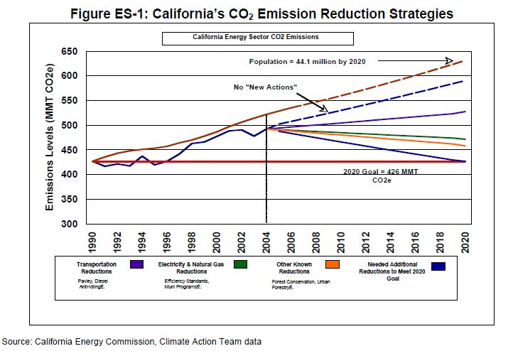

Slide 14
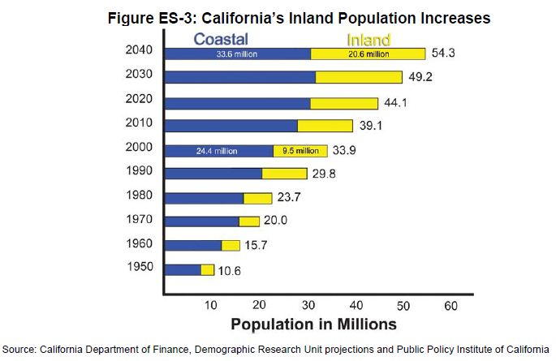

Slide 15
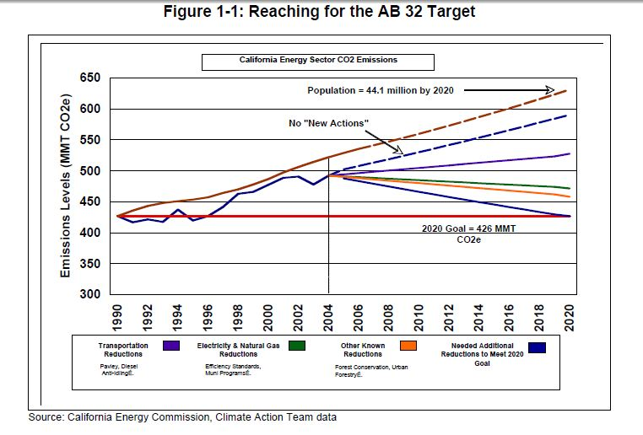

Slide 16
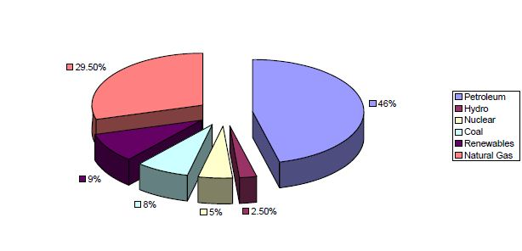

Slide 17
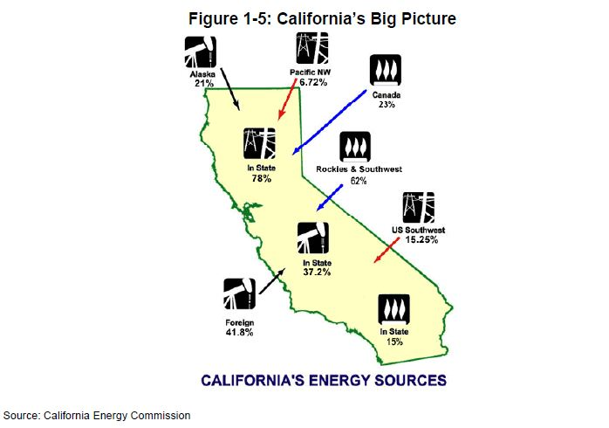

Slide 18
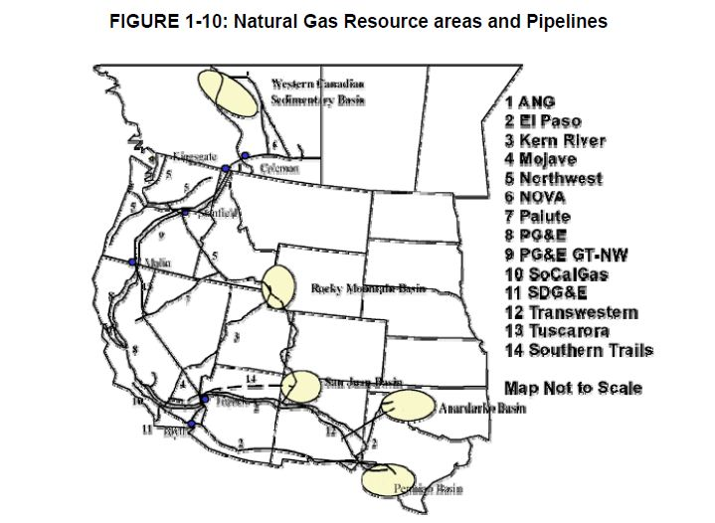

Slide 19
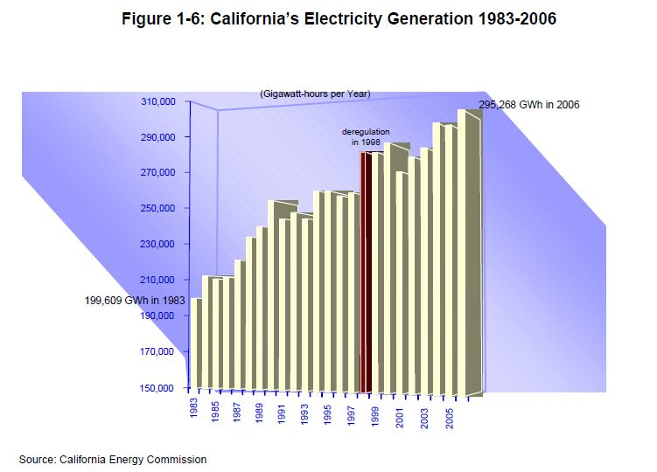

Slide 20
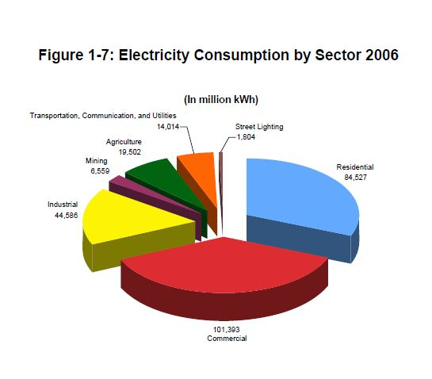

Slide 21
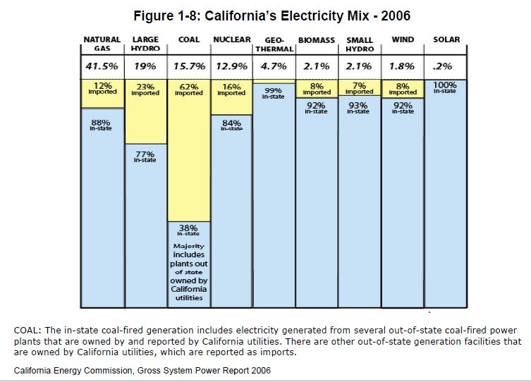

Slide 22
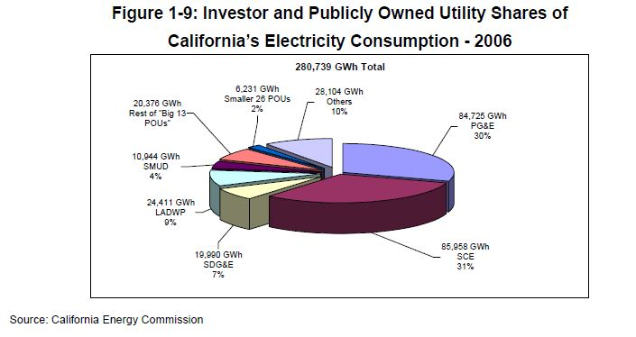

Slide 23
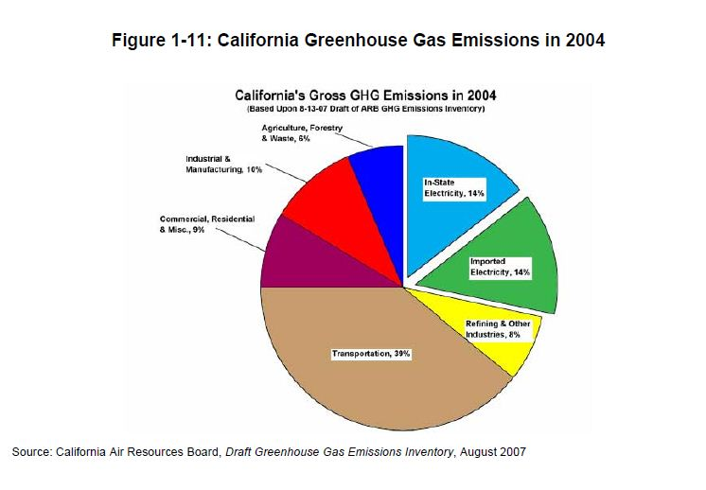

Slide 24
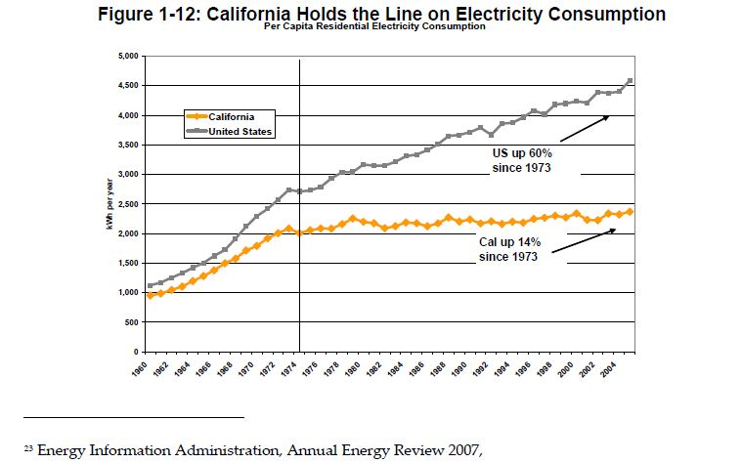

Slide 25
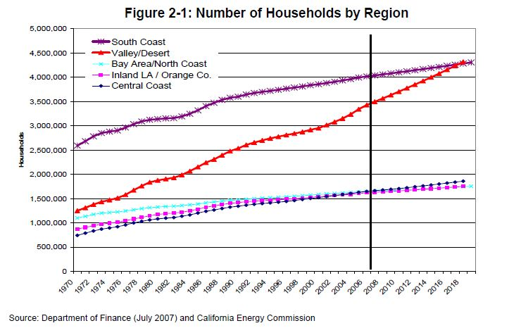

Slide 26
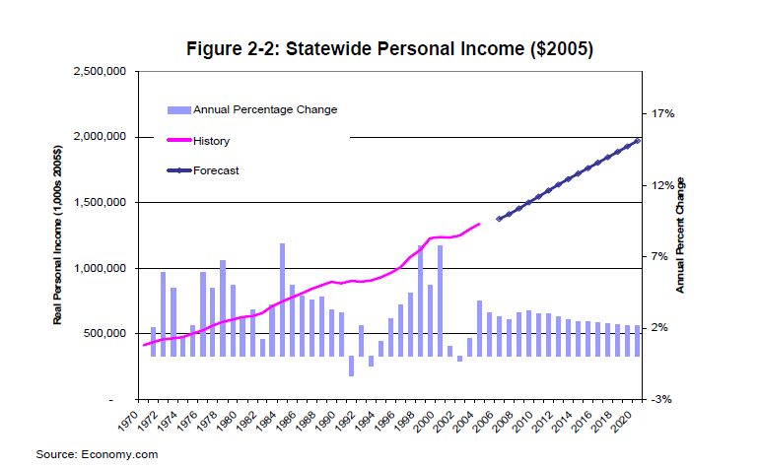

Slide 27
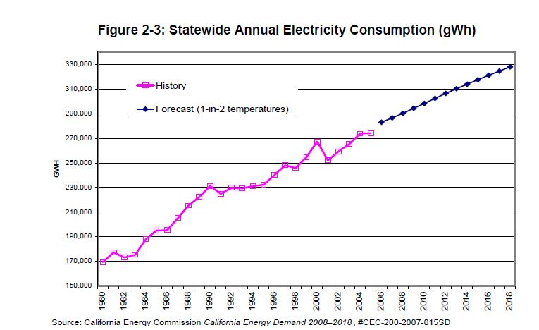

Slide 28
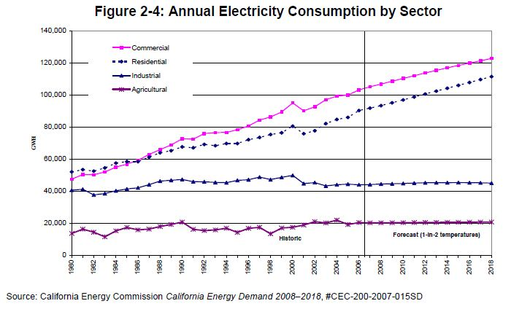

Slide 29
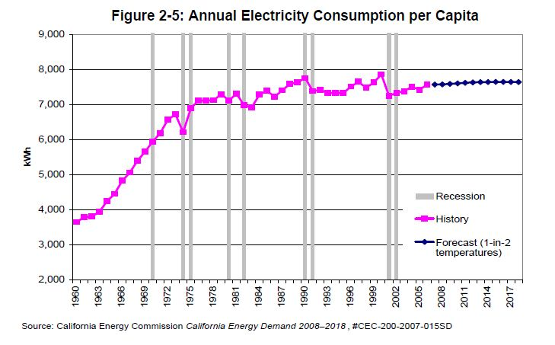

Slide 30
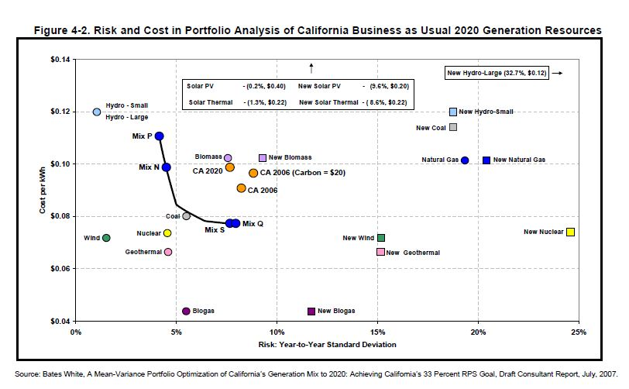

Slide 31
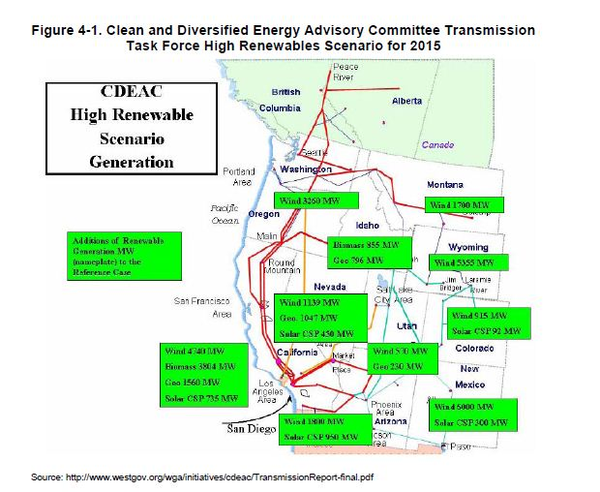

Slide 32
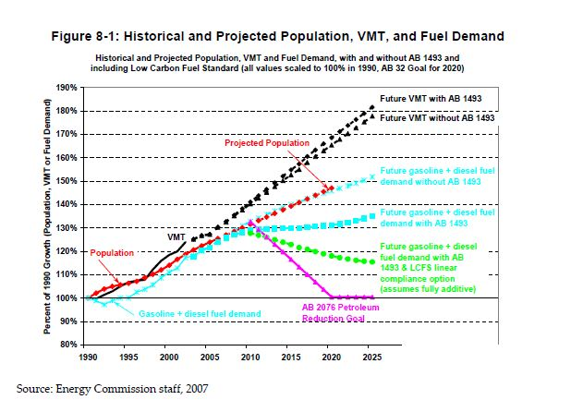

Slide 33
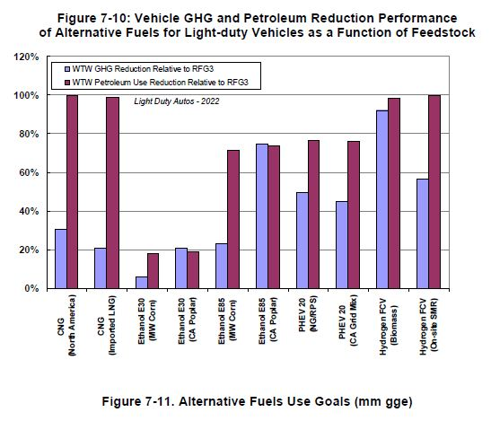

Slide 34
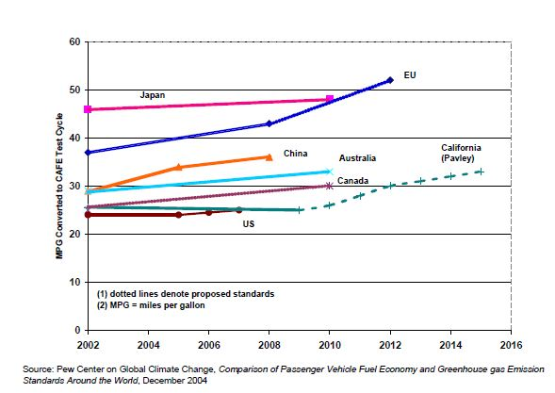

Slide 35
Recommendations
• Adopt statewide energy efficiency targets for 2016 equal to 100 percent of cost‐effective
efficiency.
• Enlist POUs in a collaborative relationship to aggressively ramp up energy efficiency
programs. POUs need to use their local conditions and customer knowledge to craft new
program ideas. In doing so, sufficient incentives need to be provided.
• Pursue legislation that would require energy audits and a cost‐effective level of
efficiency improvements at the time of sale of a building. Diagnostics and measure
verification can be completed while homes or buildings are empty, providing the
opportunity for upgrading major building systems such as windows, insulation,
lighting, HVAC and water heating.
• Initiate a formal rulemaking process in 2008 to pursue the adoption of load management
standards under its existing authority.
• Enact appliance standards to improve efficiency of appliances sold in California,
specifically targeting standards to increase the efficacy of general service lighting.
• Increase the efficiency levels of the building standards so that buildings are net zero
energy users by 2010 for residences and by 2020 for commercial buildings.
• Support behavioral and other social science research applied to customer decision
making in energy efficiency.
• Investigate market‐based approaches to energy efficiency such as the “white tag” or
“white certificate,” also known as energy efficiency certificates or credits – the analog to
renewable energy credits.

